Slide 1
Documentation images

Slide 2
Arm Virtual Hardware (AVH)
User Software development workflows
AVH infrastructure and ecosystem
AWS
Edge AI
Keil MDK
app.avh.arm.com
REST API / Web UI
Integrations via AVH REST API
GitHub
Azure
Others
VsCode
IAR
Arm Virtual Hardware (AVH)
AVH REST API
Native integrations with AVH FVPs
AVH models
AVH Corellium models
Raspberry Pi
NXP i.MX
STM32U5
…
AVH FVP models
Corstone-300
Corstone-310
Cortex-M MPS2

Slide 3
Arm Virtual Hardware (AVH)
Software development workflows: CI/CD, MLOps, embedded, …
Developer tools
VsCode
Keil MDK 6
IAR
Command-line
…
DevOps
GitHub
Jenkins
GitLab
CircleCI
…
MLOps
TDK Qeexo
Nota.ai
SageMaker
PaddlePaddle
…
Cloud Services
AWS
Azure
Oracle
Baidu Cloud
…
AVH ecosystem
…
Integrations via AVH REST API / SSH
AVH integration
AVH REST API / Web UI
app.avh.arm.com
Native integrations with AVH FVPs
AVH Corellium models
Raspberry Pi
NXP i.MX
Corstone-1000
…
AVH FVP models
Cortex-M
Corstone-300
Corstone-310
AVH models

Slide 4
Arm Virtual Hardware (AVH)
Arm FVP infrastructure
Developer tools
IDE and Debug
DevOps
CI/CD
MLOps
Model Testing
FVP targets
Corstone-3xx Subsystems CPU, NPU, ISP
Cortex-M CPUs
From M0 to M85
Desktop | Cloud Service | On-premise

Slide 5
AVH-FVPs: Arm Virtual Hardware (AVH) with Fast Models
Precise simulation models of Cortex-M device sub-systems designed for complex software verification and testing
Virtual Streaming Interface (VSI) for audio/video/sensor data
Runs on desktop, in cloud, and on-prem
Dedicated GitHub Actions for CI/CD
Docker container for non-GitHub environments
Native support in Keil Studio for VsCode
Evaluation and commercial licenses
AVH FVP infrastructure
Developer tools
IDE and Debug
DevOps
CI/CD
MLOps
Model Testing
Corstone-3xx
Subsystems CPU, NPU, ISP
Cortex-M CPUs
From M0 to M85
AVH FVP models
Desktop | Cloud Service | On-premise

Slide 6
Arm Virtual Hardware (AVH)
Software development workflows: CI/CD, MLOps, embedded, …
Developer tools
VsCode
Keil MDK 6
IAR
Command-line
…
DevOps
GitHub
Jenkins
GitLab
CircleCI
…
MLOps
TDK Qeexo
Nota.ai
SageMaker
PaddlePaddle
…
Cloud Services
AWS
Azure
Oracle
Baidu Cloud
…
AVH ecosystem
…
Integrations via AVH REST API / SSH
AVH integration
AVH REST API / Web UI
app.avh.arm.com
Native integrations with AVH FVPs
AVH Corellium models
Raspberry Pi
NXP i.MX
Corstone-1000
…
AVH FVP models
Cortex-M
Corstone-300
Corstone-310
…
AVH models
Cloud-native
Cloud or Desktop

Slide 7
Arm Fixed Virtual Platforms (FVPs)
Precise simulation models of Cortex-M device sub-systems designed for complex software verification and testing
Runs any RTOS or bare metal code
Provides virtual peripheral interfaces for I/O simulation
Enables test automation of diverse software workloads, including unit, integration tests, and fault injection
Cloud service that can be integrated in CI/CD and MLOps development flows
Arm Fixed Virtual Platform (FVP) Corstone-300
Developer Resources
Cortex-M55
TrustZone
Helium
Ethos-U55
microNPU
I/O drivers
Test scripts
CI/CD integration
Usage examples
Test report tools
Memory
Secure/ Non-secure
DMA
Peripherals
GPIO
UART, SPI, I²C
Ethernet
Arm Virtual Hardware Service
Virtual I/O
Data values
Streaming
BSD-Socket
Debug Interface
MDK, DS
GDB
Event Recorder
Arm VHT Models
C/C++ Compiler
Build utilities

Slide 8
Arm Virtual Hardware
Precise simulation models of Cortex-M device sub-systems designed for complex software verification and testing
Runs any RTOS or bare metal code
Provides virtual peripheral interfaces for I/O simulation
Enables test automation of diverse software workloads, including unit, integration tests, and fault injection
Cloud service that can be integrated in CI/CD and MLOps development flows
Arm Fixed Virtual Platforms (FVPs)
of all Cortex-M Processors
Developer Resources
Cortex-M
TrustZone
SIMD
Helium
Ethos-U65/U55
microNPU
I/O drivers
Test scripts
CI/CD integration
Usage examples
Test report tools
Memory
Secure/ Non-secure
DMA
Peripherals
GPIO
UART, SPI, I²C
Ethernet
AWS Cloud Service
Virtual I/O
Data values
Streaming
BSD-Socket
Debug Interface
MDK, DS
GDB
Event Recorder
Arm FVP models
C/C++ Compiler
Build utilities

Slide 9
Virtual Hardware: Test Cloud Applications with Internet Connectivity
User Application Code (Example)
CMSIS-RTOS2
Application that connects to Internet via BSD-Socket
This is a complex user application that requires internet connectivity
FreeRTOS, RTX, …
Demo or test Interface
i.e. Voice Recognition
TCP/IP Network Stack
Event Recorder
Ethernet
The interface layer can be re-targeted to physical hardware
Virtual Interfaces
CMSIS-VIO for Switches/LEDs
Audio Driver VSI
Ethernet Driver
Virtual Target
Event Recorder Capturing
Demo I/O Interface (VIO)
Virtual Streaming Interface (VSI)
Virtual Socket Interface (VSocket)
VSI is under user control and can service also Video or Sensor data
Maps also to a graphical user panel
Events on changes of LEDs
Python Interface:
- Script for Audio input/output
Connection to the Internet via Socket
Up to 8 VSI instances are supported
Notes:
Potential key customer: DSP Concepts. See email exchange:
From: Paul Beckmann <pbeckmann@dspconcepts.com> Sent: Wednesday, April 7, 2021 9:05 PM To: Reinhard Keil <Reinhard.Keil@arm.com> Subject: Re: Compiler comparison / Feedback on Audio API interface
Hi Reinhard,
We are our testing with MDK V5.31.0.0. Here is the detailed info:
For IAR, we used v8.50.1. For GCC, it was the version included with the ST tools. Not sure exactly which version this was.
We have done further benchmarking across different signal processing operations. I picked this one because it was a recent issue with a customer and highlights how GCC can be slow. For other kernels, the cycle counts are comparable.
Being able to run on the FVP would be very interesting for us. I see several advantages:
We can optimize and profile for cores before they are publicly available. For example, we are getting requests for M55 performance numbers but there are no announced CPUs.
Get accurate measurements of system level issues. Caching and memory accesses have a huge impact.
Could fit with our continuous integration plans so that we don't have to (always) test on external hardware.
We are speaking with Reed Hinkel about "cloud based profiling". I would like our customers to create a design in Audio Weaver and then upload the design to our website for profiling. They can select which processors to run on and then get detailed results showing where resources are consumed. The VFP would be ideal for this.
I also had one of my firmware engineers review the SAI interface. I'll provide all of his comments and you can see what is relevant:
It is well written and to make sure I understand it, low-level drivers must be written depending on the device.
You have to kickstart the driver with calls to ARM_SAI_Receive() or ARM_SAI_Send() which are non-blocking.
A callback function is registered during init called ARM_SAI_SignalEvent(event) which is called when the above completes with respective bits in the parameter "event" for each.
ARM_SAI_Receive() or ARM_SAI_Send() mention that DMA is typical, but I am not sure if those two calls can be one time only and then the guts of the driver can provide calls to ARM_SAI_SignalEvent(event) on each DMA interrupt afterward. If yes, then it can work with our BSP's.
The protocols cover about everything with User Defined Protocol allowing for generic TDM configuration.
They are missing specification of left or right adjusted data and now to save captured data in memory. For instance if the data is 24-bits, is it saved right adjusted with sign extension or left adjusted?
In general, you may capture even 16-bit data and want to save it in 32-bit memory left or right adjusted.
The same API and supported protocols should include PDM (DMIC) input. The RT685 and NXP PDM IP in general have a means to convert to I2S, but that may not be on all parts and should not be necessary.
Most devices have multiple stereo PDM ports that can capture data and send to two different DMA channels (left and right).
This API seems to support single stream, interleaved, not multi-stream from one device. Is that correct?
The documentation is not clear how you mask the TX event, bot allow the RX event and so on. Guessing it is in there.

Slide 10
Virtual Hardware: Test Cloud Applications with Internet Connectivity
User Application Code (Example)
CMSIS-RTOS2
Application that connects to Internet via BSD-Socket
This is a complex user application that requires internet connectivity
FreeRTOS, RTX, …
Demo or test Interface
i.e. Voice Recognition
Event Recorder
BSD-Socket
The interface layer can be re-targeted to physical hardware
Virtual Interfaces
CMSIS-VIO for Switches/LEDs
Audio Driver VSI
Socket Driver VSocket
Virtual Target
Event Recorder Capturing
Demo I/O Interface (VIO)
Virtual Streaming Interface (VSI)
Virtual Socket Interface (VSocket)
VSI is under user control and can service also Video or Sensor data
Maps also to a graphical user panel
Events on changes of LEDs
Python Interface:
- Script for Audio input/output
Connection to the Internet via Socket
Up to 8 VSI instances are supported
Notes:
Potential key customer: DSP Concepts. See email exchange:
From: Paul Beckmann <pbeckmann@dspconcepts.com> Sent: Wednesday, April 7, 2021 9:05 PM To: Reinhard Keil <Reinhard.Keil@arm.com> Subject: Re: Compiler comparison / Feedback on Audio API interface
Hi Reinhard,
We are our testing with MDK V5.31.0.0. Here is the detailed info:
For IAR, we used v8.50.1. For GCC, it was the version included with the ST tools. Not sure exactly which version this was.
We have done further benchmarking across different signal processing operations. I picked this one because it was a recent issue with a customer and highlights how GCC can be slow. For other kernels, the cycle counts are comparable.
Being able to run on the FVP would be very interesting for us. I see several advantages:
We can optimize and profile for cores before they are publicly available. For example, we are getting requests for M55 performance numbers but there are no announced CPUs.
Get accurate measurements of system level issues. Caching and memory accesses have a huge impact.
Could fit with our continuous integration plans so that we don't have to (always) test on external hardware.
We are speaking with Reed Hinkel about "cloud based profiling". I would like our customers to create a design in Audio Weaver and then upload the design to our website for profiling. They can select which processors to run on and then get detailed results showing where resources are consumed. The VFP would be ideal for this.
I also had one of my firmware engineers review the SAI interface. I'll provide all of his comments and you can see what is relevant:
It is well written and to make sure I understand it, low-level drivers must be written depending on the device.
You have to kickstart the driver with calls to ARM_SAI_Receive() or ARM_SAI_Send() which are non-blocking.
A callback function is registered during init called ARM_SAI_SignalEvent(event) which is called when the above completes with respective bits in the parameter "event" for each.
ARM_SAI_Receive() or ARM_SAI_Send() mention that DMA is typical, but I am not sure if those two calls can be one time only and then the guts of the driver can provide calls to ARM_SAI_SignalEvent(event) on each DMA interrupt afterward. If yes, then it can work with our BSP's.
The protocols cover about everything with User Defined Protocol allowing for generic TDM configuration.
They are missing specification of left or right adjusted data and now to save captured data in memory. For instance if the data is 24-bits, is it saved right adjusted with sign extension or left adjusted?
In general, you may capture even 16-bit data and want to save it in 32-bit memory left or right adjusted.
The same API and supported protocols should include PDM (DMIC) input. The RT685 and NXP PDM IP in general have a means to convert to I2S, but that may not be on all parts and should not be necessary.
Most devices have multiple stereo PDM ports that can capture data and send to two different DMA channels (left and right).
This API seems to support single stream, interleaved, not multi-stream from one device. Is that correct?
The documentation is not clear how you mask the TX event, bot allow the RX event and so on. Guessing it is in there.

Slide 11
IoT/ML SW Platform – from FVP to Hardware to Deployment
Ease-of-Use with Open-CMSIS and Keil Studio; provide evidence of correctness on FVP and real deployment
User Application Code
SW system under test
Simulation layer
Virtual I/O Drivers
Virtual CPU
Stimuli input
Event Log file
Notes:
Potential key customer: DSP Concepts. See email exchange:
From: Paul Beckmann <pbeckmann@dspconcepts.com> Sent: Wednesday, April 7, 2021 9:05 PM To: Reinhard Keil <Reinhard.Keil@arm.com> Subject: Re: Compiler comparison / Feedback on Audio API interface
Hi Reinhard,
We are our testing with MDK V5.31.0.0. Here is the detailed info:
For IAR, we used v8.50.1. For GCC, it was the version included with the ST tools. Not sure exactly which version this was.
We have done further benchmarking across different signal processing operations. I picked this one because it was a recent issue with a customer and highlights how GCC can be slow. For other kernels, the cycle counts are comparable.
Being able to run on the FVP would be very interesting for us. I see several advantages:
We can optimize and profile for cores before they are publicly available. For example, we are getting requests for M55 performance numbers but there are no announced CPUs.
Get accurate measurements of system level issues. Caching and memory accesses have a huge impact.
Could fit with our continuous integration plans so that we don't have to (always) test on external hardware.
We are speaking with Reed Hinkel about "cloud based profiling". I would like our customers to create a design in Audio Weaver and then upload the design to our website for profiling. They can select which processors to run on and then get detailed results showing where resources are consumed. The VFP would be ideal for this.
I also had one of my firmware engineers review the SAI interface. I'll provide all of his comments and you can see what is relevant:
It is well written and to make sure I understand it, low-level drivers must be written depending on the device.
You have to kickstart the driver with calls to ARM_SAI_Receive() or ARM_SAI_Send() which are non-blocking.
A callback function is registered during init called ARM_SAI_SignalEvent(event) which is called when the above completes with respective bits in the parameter "event" for each.
ARM_SAI_Receive() or ARM_SAI_Send() mention that DMA is typical, but I am not sure if those two calls can be one time only and then the guts of the driver can provide calls to ARM_SAI_SignalEvent(event) on each DMA interrupt afterward. If yes, then it can work with our BSP's.
The protocols cover about everything with User Defined Protocol allowing for generic TDM configuration.
They are missing specification of left or right adjusted data and now to save captured data in memory. For instance if the data is 24-bits, is it saved right adjusted with sign extension or left adjusted?
In general, you may capture even 16-bit data and want to save it in 32-bit memory left or right adjusted.
The same API and supported protocols should include PDM (DMIC) input. The RT685 and NXP PDM IP in general have a means to convert to I2S, but that may not be on all parts and should not be necessary.
Most devices have multiple stereo PDM ports that can capture data and send to two different DMA channels (left and right).
This API seems to support single stream, interleaved, not multi-stream from one device. Is that correct?
The documentation is not clear how you mask the TX event, bot allow the RX event and so on. Guessing it is in there.

Slide 12
FVP Platform for IoT/DSP/ML Software Development
CMSIS-RTOS2
User Application Code
Application that connects to Internet via BSD-Socket
FreeRTOS, RTX, …
BSD-Socket
Demo or test Interface
i.e. Voice Recognition
Event Recorder
Simulation layer
Demo I/O-Driver
Peripheral Driver (e.g., Audio)
Virtual Socket (VSocket)
Virtual Streaming Interface (VSI)
Events on changes of LEDs
Python Interface for streaming input
Connection to the Internet via Socket
Notes:
Potential key customer: DSP Concepts. See email exchange:
From: Paul Beckmann <pbeckmann@dspconcepts.com> Sent: Wednesday, April 7, 2021 9:05 PM To: Reinhard Keil <Reinhard.Keil@arm.com> Subject: Re: Compiler comparison / Feedback on Audio API interface
Hi Reinhard,
We are our testing with MDK V5.31.0.0. Here is the detailed info:
For IAR, we used v8.50.1. For GCC, it was the version included with the ST tools. Not sure exactly which version this was.
We have done further benchmarking across different signal processing operations. I picked this one because it was a recent issue with a customer and highlights how GCC can be slow. For other kernels, the cycle counts are comparable.
Being able to run on the FVP would be very interesting for us. I see several advantages:
We can optimize and profile for cores before they are publicly available. For example, we are getting requests for M55 performance numbers but there are no announced CPUs.
Get accurate measurements of system level issues. Caching and memory accesses have a huge impact.
Could fit with our continuous integration plans so that we don't have to (always) test on external hardware.
We are speaking with Reed Hinkel about "cloud based profiling". I would like our customers to create a design in Audio Weaver and then upload the design to our website for profiling. They can select which processors to run on and then get detailed results showing where resources are consumed. The VFP would be ideal for this.
I also had one of my firmware engineers review the SAI interface. I'll provide all of his comments and you can see what is relevant:
It is well written and to make sure I understand it, low-level drivers must be written depending on the device.
You have to kickstart the driver with calls to ARM_SAI_Receive() or ARM_SAI_Send() which are non-blocking.
A callback function is registered during init called ARM_SAI_SignalEvent(event) which is called when the above completes with respective bits in the parameter "event" for each.
ARM_SAI_Receive() or ARM_SAI_Send() mention that DMA is typical, but I am not sure if those two calls can be one time only and then the guts of the driver can provide calls to ARM_SAI_SignalEvent(event) on each DMA interrupt afterward. If yes, then it can work with our BSP's.
The protocols cover about everything with User Defined Protocol allowing for generic TDM configuration.
They are missing specification of left or right adjusted data and now to save captured data in memory. For instance if the data is 24-bits, is it saved right adjusted with sign extension or left adjusted?
In general, you may capture even 16-bit data and want to save it in 32-bit memory left or right adjusted.
The same API and supported protocols should include PDM (DMIC) input. The RT685 and NXP PDM IP in general have a means to convert to I2S, but that may not be on all parts and should not be necessary.
Most devices have multiple stereo PDM ports that can capture data and send to two different DMA channels (left and right).
This API seems to support single stream, interleaved, not multi-stream from one device. Is that correct?
The documentation is not clear how you mask the TX event, bot allow the RX event and so on. Guessing it is in there.

Slide 13
FVP Platform for IoT/DSP/ML Software Development
User Application Code
Application
Software Under Test (e.g. voice recognition)
Simulation layer
Audio Driver
(audio_drv.h/.c)
Virtual Streaming Interface
(arm_vsi.h)
Python Audio streaming Interface
(audio/.../arm_vsi0.py)
Audio files
Notes:
Potential key customer: DSP Concepts. See email exchange:
From: Paul Beckmann <pbeckmann@dspconcepts.com> Sent: Wednesday, April 7, 2021 9:05 PM To: Reinhard Keil <Reinhard.Keil@arm.com> Subject: Re: Compiler comparison / Feedback on Audio API interface
Hi Reinhard,
We are our testing with MDK V5.31.0.0. Here is the detailed info:
For IAR, we used v8.50.1. For GCC, it was the version included with the ST tools. Not sure exactly which version this was.
We have done further benchmarking across different signal processing operations. I picked this one because it was a recent issue with a customer and highlights how GCC can be slow. For other kernels, the cycle counts are comparable.
Being able to run on the FVP would be very interesting for us. I see several advantages:
We can optimize and profile for cores before they are publicly available. For example, we are getting requests for M55 performance numbers but there are no announced CPUs.
Get accurate measurements of system level issues. Caching and memory accesses have a huge impact.
Could fit with our continuous integration plans so that we don't have to (always) test on external hardware.
We are speaking with Reed Hinkel about "cloud based profiling". I would like our customers to create a design in Audio Weaver and then upload the design to our website for profiling. They can select which processors to run on and then get detailed results showing where resources are consumed. The VFP would be ideal for this.
I also had one of my firmware engineers review the SAI interface. I'll provide all of his comments and you can see what is relevant:
It is well written and to make sure I understand it, low-level drivers must be written depending on the device.
You have to kickstart the driver with calls to ARM_SAI_Receive() or ARM_SAI_Send() which are non-blocking.
A callback function is registered during init called ARM_SAI_SignalEvent(event) which is called when the above completes with respective bits in the parameter "event" for each.
ARM_SAI_Receive() or ARM_SAI_Send() mention that DMA is typical, but I am not sure if those two calls can be one time only and then the guts of the driver can provide calls to ARM_SAI_SignalEvent(event) on each DMA interrupt afterward. If yes, then it can work with our BSP's.
The protocols cover about everything with User Defined Protocol allowing for generic TDM configuration.
They are missing specification of left or right adjusted data and now to save captured data in memory. For instance if the data is 24-bits, is it saved right adjusted with sign extension or left adjusted?
In general, you may capture even 16-bit data and want to save it in 32-bit memory left or right adjusted.
The same API and supported protocols should include PDM (DMIC) input. The RT685 and NXP PDM IP in general have a means to convert to I2S, but that may not be on all parts and should not be necessary.
Most devices have multiple stereo PDM ports that can capture data and send to two different DMA channels (left and right).
This API seems to support single stream, interleaved, not multi-stream from one device. Is that correct?
The documentation is not clear how you mask the TX event, bot allow the RX event and so on. Guessing it is in there.

Slide 14
FVP/FM Streaming Peripheral Extension
The streaming peripheral is flexible and allows to implement a wide range of use cases for sensors, audio and video.
First PoC implementation of Streaming Interface
Host: Linux / Windows
Arm FVP model
(Fixed Virtual Platform,
example: Corstone-300 FVP)
Python scripts with callback functions for custom actions on read/write access to VSI registers.
For example: for audio file as input/output.
Application firmware
User application
Peripheral Driver
Example: audio I/O
Virtual Streaming Interface (VSI)
CPU peripheral with register interface
VSI python scripts arm_vsi0.py, arm_vsi1.py, …
Audio file ‘test.wav’
Data files (’test.wav’)
Peripheral driver abstracts VSI register accesses for a specific use case. For example: audio I/O driver.
8 VSI instances can be used in parallel for multi-channel I/O

Slide 15
Video VSI Use Case
Application firmware
AVH FVP model
Post-processing
Video Driver
(over VSI)
Virtual Streaming Interface (VSI)
Input stream
ML Algorithm
Output stream (optional)
vsi_video_server.py: stream in
VSI Python API (arm_vsi4.py)
Video Input image/video file, PC cam
Frame drop
Crop/resize
Change color space
vsi_video.py
vsi_video_server.py: stream out
VSI Python API (arm_vsi6.py)
Video Output image/video file, PC screen
Change color space
Crop/resize
vsi_video.py
Python scripts

Slide 16
Application
Control / Status
ML Algorithm
Stream In
Video driver
Post-processing
Stream Out
PC
VSI Video Server: Stream In
VSI
Video input
(PC camera, bmp, png, jpg, wmv, avi, mp4)
Frame drop
Crop/resize
Change color space
VSI Video
VSI Video Server: Stream Out
VSI
Video output
(PC screen, bmp, png, jpg, wmv, avi, mp4)
Change color space
Crop/resize
VSI Video

Slide 17
FVP/FM Streaming Peripheral Extension
First PoC implementation of Streaming Interface
The Cortex-M side implements a flexible streaming peripheral that can serve a wide range of use cases. For example, audio I/O.
The streaming peripheral is flexible and allows to implement a wide range of use cases. We show an audio interface in the first example.
Arm FVP
(Fixed Virtual Platform,
example: Corstone-300)
Cortex-M User Application
Algorithm under Test
Audio I/O Peripheral Driver
Virtual Streaming Interface (VSI) Peripheral with Register Interface
Python test script Audio Streaming Interface
Audio file ‘test.wav’
Audio files ‘test.wav’
In an example we provide the same Audio Peripheral Driver API implemented on a real microcontroller.

Slide 18
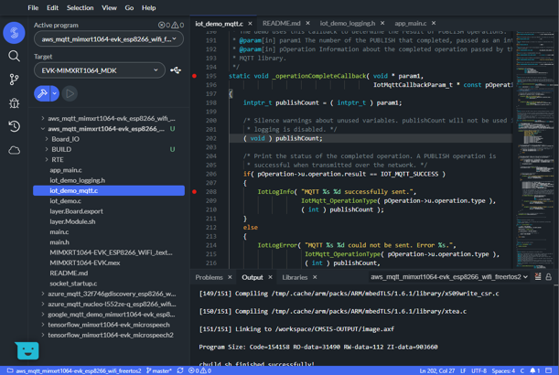
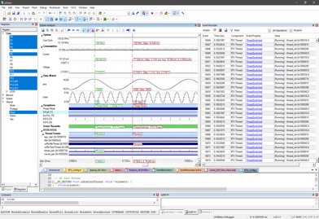

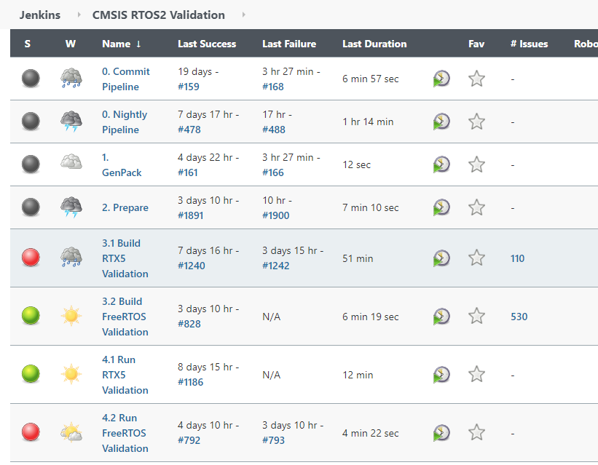
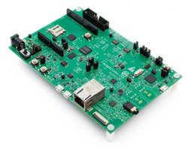
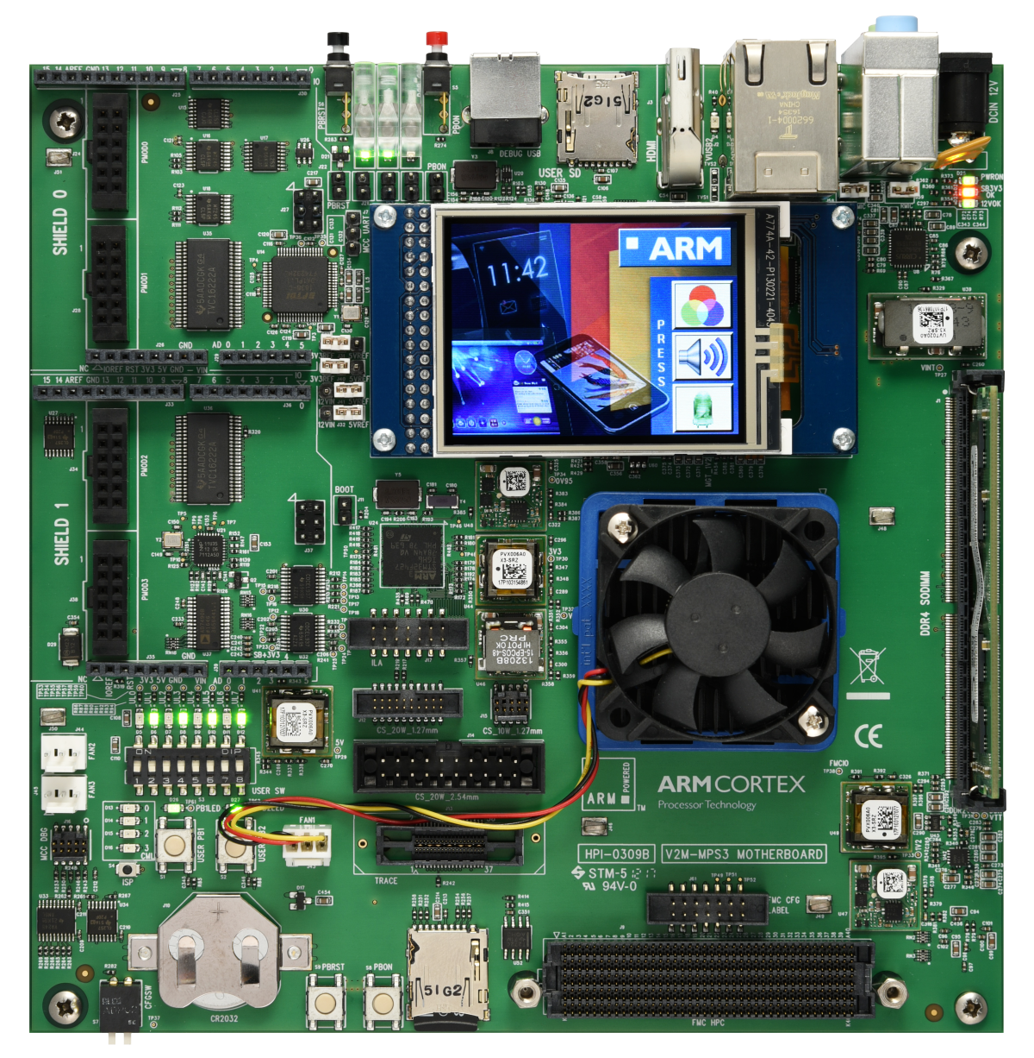
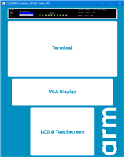
Workflow for CI: Develop Application Code or Test Cases
CI hosted in the Cloud
Classic Desktop Tools (Keil MDK, Arm DS)
Cloud flow with IDE in Browser
GitHub – Runners
Commit triggers GitHub Actions that start CI using Arm Compiler for build and/or Virtual Hardware for testing.
GitHub Commit
Test Results
Hardware Boards on your Desk
Develop Test cases
Deploy to bespoke hardware
Arm
FVPs
All environments generate Event Log files for off-line analysis
Evaluation Board
MPS3 with FPGA image
Simulation
Target Hardware

Slide 19
FVP/FM I/O Peripheral Extension
Application on the Cortex-M side can use CMSIS-Driver VIO for the peripheral control
Arm FVP
(Fixed Virtual Platform,
example: Corstone-300)
Cortex-M Application
User Application
CMSIS-Driver VIO Peripheral Driver
Virtual Input/Output Interface (VIO) Peripheral with Register Interface
Python script VIO controls

Slide 20
FVP/FM IP Socket Peripheral Extension
Application on the Cortex-M side can use IoT Socket API for the peripheral control
Arm FVP
(Fixed Virtual Platform,
example: Corstone-300)
Cortex-M User Application
Application
IP Socket API example: IoT Socket
Virtual Socket Interface (VSocket) Peripheral with Register Interface
Host BSD Sockets

Slide 21

IDE development
Local installation
CI development
Jenkins/GitHub/GitLab/…
Create and Debug
Test Automation
Keil MDK with:
Interactive Debug and Trace Views
Arm Compiler
Arm Virtual Hardware
Cloud Service with:
Arm Virtual Hardware
Virtual development boards
Version Control System Code Repository
Developer 1 Local Builds
Developer 2 Local Builds
Developer ‘n’ Local Builds
Multiple Builds
Regression Tests
Verification
Results
Developer 1 Local Debug
Developer 2 Local Debug
Developer ‘n’ Local Debug

Slide 22

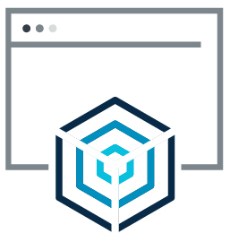

Arm Virtual Hardware
Code update
Code Repository
Start CI
Build
Test
Results
CI Pipeline
Obtain CI results
Return CI results

Slide 23

Arm Virtual Hardware Infrastructure
Code update
Code Repository
Start CI
Build
Test
Results
Local development & debug
CI Pipeline
Return CI results
FVP models
Hardware boards

Slide 24
Current Docker Container
https://community.arm.com/developer/tools-software/tools/b/tools-software-ides-blog/posts/infrastructure-for-continuous-integration-tests
Content https://hub.docker.com/r/armswdev/cmsis_tools_m55
GCC, AC6, FVP Corstone-300 (Cortex-M55), CMSIS pack
Improvement potential
Better integration to github flows
Event Recorder for timing measurement
Ways to specify packs that are outside of the container
Ways to specify python scripts and simulation data that are outside of the container
Better examples that show real-world cases
Getting test results to the user
We need to simplify the way to get useful test results to the user (ideally to the persons that did the commit).

Slide 25
FVP/FM Streaming Peripheral Extension
First PoC implementation of Streaming Interface
FVP Implementation for Linux and Windows
The streaming peripheral is flexible and allows to implement a wide range of use cases. We show an audio interface in the first example.
Corstone-300 Model
Also, the Cortex-M side implements a flexible streaming peripheral that can serve a wide range of use cases. Initially we show audio.
Cortex-M User Application
Virtual Streaming Interface (VSI) Peripheral with Register Interface
Audio Input Peripheral Driver
Algorithm under Test
Python test script Audio Streaming Interface
Audio file ‘test.wav’
In an example we provide the same Audio Peripheral Driver API implemented on a real microcontroller

Slide 26
Audio Driver
Audio Buffer Handling
Streaming driver for audio data
Support for multiple channels
[support for multiple data formats – after first iteration]
Data transfer in blocks to maximize simulation speed (as it reduces interaction
Callback Event at each block transfer
BlockCount
Data #0
Data #0
Data #0
Data #0
Data #1
Data #1
Data #1
Data #1
Data #2
Data #2
Data #2
Data #2
Data #3
Data #3
Data #3
Data #3
…………
…………
…………
…………
…………
BlockSize
Data #n-1
Data #n-1
Data #n-1
Data #n-1
Block #0
Block #1
Block #2
Block #m
rotating with 2^n blocks

Slide 27
Software, Peripheral, and Script interaction
Cortex-M Software
VSI Peripheral
VSI Python Script
Setup Peripheral
Setup Data Transfer
Write DMA registers
Capture Data Block Size
Start Operation
Write Timer registers
Capture Timer setup
Timer event
Driver Event (New Data)
Copy Data Block #0
Timer event
Driver Event (New Data)
Copy Data Block #1
…
…
Timer event
Driver Event (New Data)
Copy Data Block #n
Stop Operation
Write registers
Capture Register Values

Slide 28
FVP Platform for IoT/DSP/ML Software Development
CMSIS-RTOS2
User Application Code
Application that connects to Internet via BSD-Socket
FreeRTOS, RTX, …
BSD-Socket
Demo or test Interface
i.e. Voice Recognition
Event Recorder
FVP Layer
Demo I/O-Driver
Audio Driver
Virtual Socket (VSocket)
Virtual Streaming Interface (VSI)
This can is under full user control and can service also Video or Sensor data
Events on changes of LEDs
Python Interface:
- Script for Audio input
Connection to the Internet via Socket
Up to 8 VSI instances are supported
Notes:
Potential key customer: DSP Concepts. See email exchange:
From: Paul Beckmann <pbeckmann@dspconcepts.com> Sent: Wednesday, April 7, 2021 9:05 PM To: Reinhard Keil <Reinhard.Keil@arm.com> Subject: Re: Compiler comparison / Feedback on Audio API interface
Hi Reinhard,
We are our testing with MDK V5.31.0.0. Here is the detailed info:
For IAR, we used v8.50.1. For GCC, it was the version included with the ST tools. Not sure exactly which version this was.
We have done further benchmarking across different signal processing operations. I picked this one because it was a recent issue with a customer and highlights how GCC can be slow. For other kernels, the cycle counts are comparable.
Being able to run on the FVP would be very interesting for us. I see several advantages:
We can optimize and profile for cores before they are publicly available. For example, we are getting requests for M55 performance numbers but there are no announced CPUs.
Get accurate measurements of system level issues. Caching and memory accesses have a huge impact.
Could fit with our continuous integration plans so that we don't have to (always) test on external hardware.
We are speaking with Reed Hinkel about "cloud based profiling". I would like our customers to create a design in Audio Weaver and then upload the design to our website for profiling. They can select which processors to run on and then get detailed results showing where resources are consumed. The VFP would be ideal for this.
I also had one of my firmware engineers review the SAI interface. I'll provide all of his comments and you can see what is relevant:
It is well written and to make sure I understand it, low-level drivers must be written depending on the device.
You have to kickstart the driver with calls to ARM_SAI_Receive() or ARM_SAI_Send() which are non-blocking.
A callback function is registered during init called ARM_SAI_SignalEvent(event) which is called when the above completes with respective bits in the parameter "event" for each.
ARM_SAI_Receive() or ARM_SAI_Send() mention that DMA is typical, but I am not sure if those two calls can be one time only and then the guts of the driver can provide calls to ARM_SAI_SignalEvent(event) on each DMA interrupt afterward. If yes, then it can work with our BSP's.
The protocols cover about everything with User Defined Protocol allowing for generic TDM configuration.
They are missing specification of left or right adjusted data and now to save captured data in memory. For instance if the data is 24-bits, is it saved right adjusted with sign extension or left adjusted?
In general, you may capture even 16-bit data and want to save it in 32-bit memory left or right adjusted.
The same API and supported protocols should include PDM (DMIC) input. The RT685 and NXP PDM IP in general have a means to convert to I2S, but that may not be on all parts and should not be necessary.
Most devices have multiple stereo PDM ports that can capture data and send to two different DMA channels (left and right).
This API seems to support single stream, interleaved, not multi-stream from one device. Is that correct?
The documentation is not clear how you mask the TX event, bot allow the RX event and so on. Guessing it is in there.

Slide 29
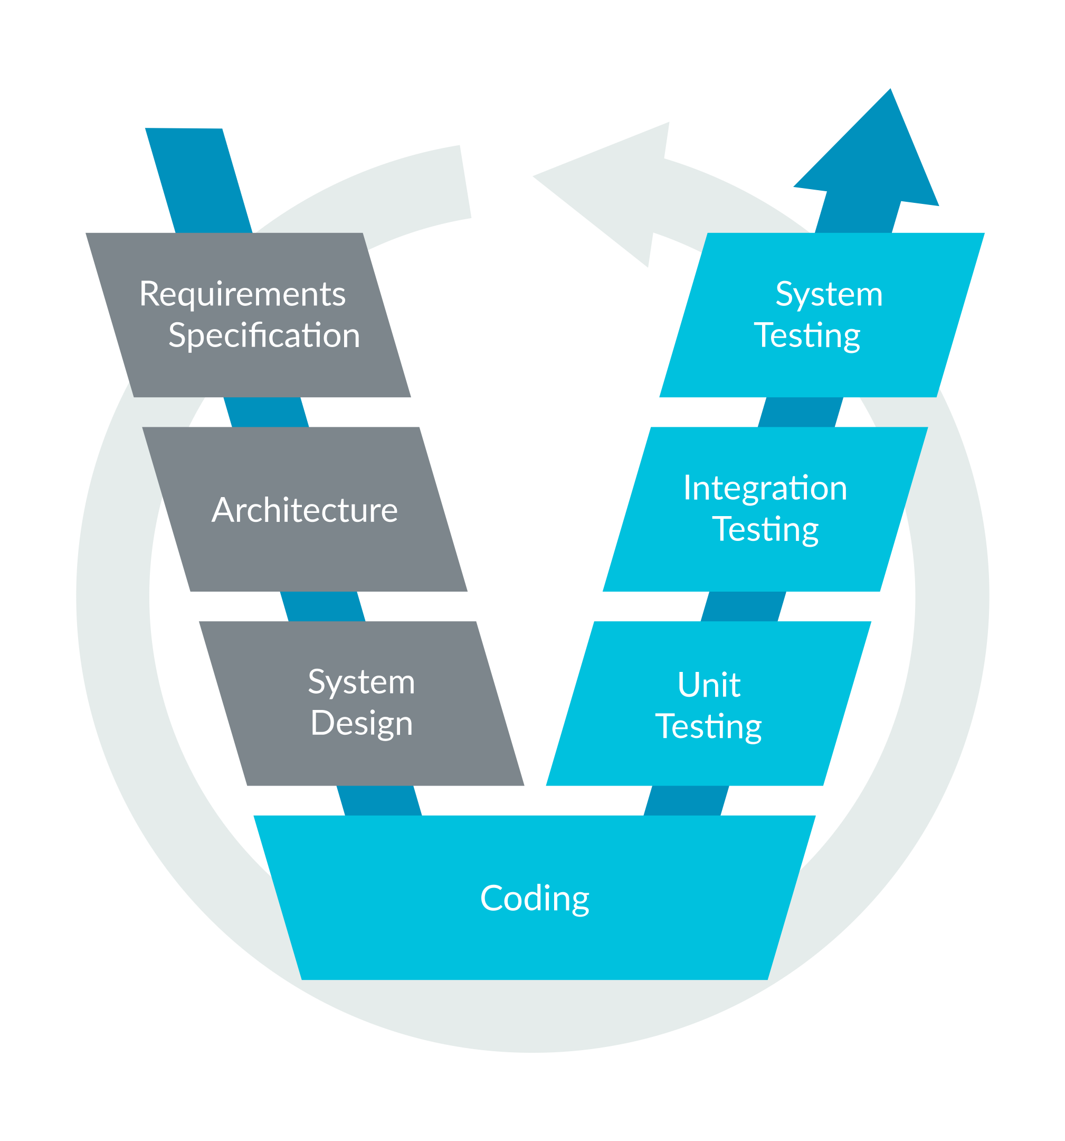
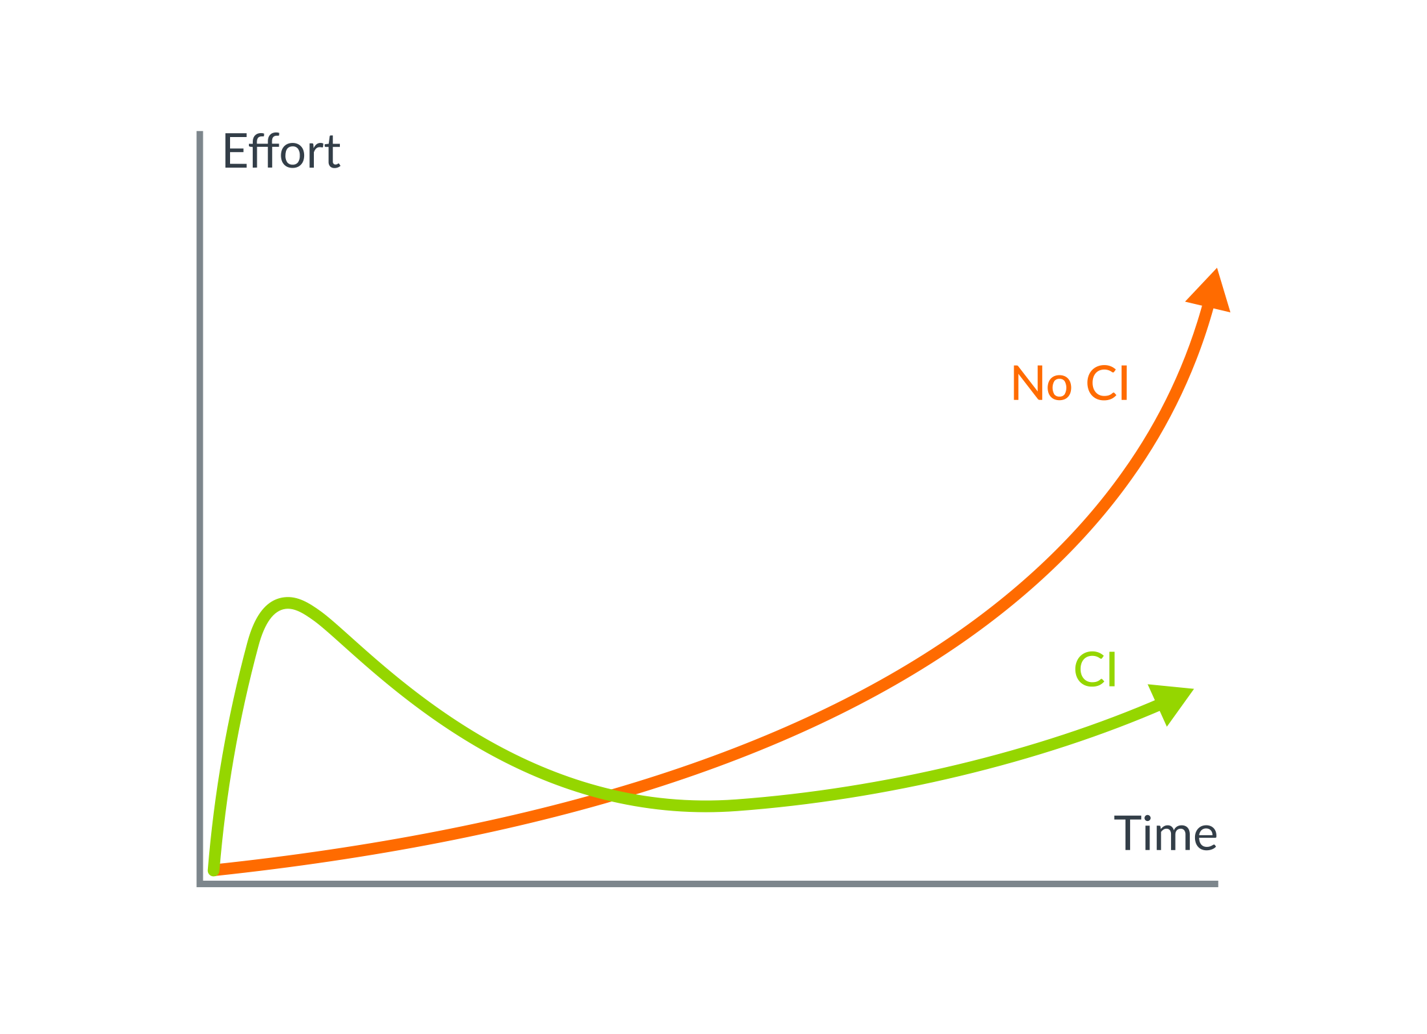
Types of Software Testing
Better quality faster, conforming to safety standards
Unit Testing
Test little chunks of code at a time.
Tested against your ‘test’ build.
Integration Testing
Test whether two components work together when they are combined. Verifies that the interface between them works properly.
Tested against your ‘test’ build.
System (Black-box) Testing
Test that final system works as expected. Control external controls & stimuli to system and measure response.
Tested against your ‘release’ build.
Regression Testing
Suite of tests (unit & integration tests) & run continuously upon version control updates.
Used in Continuous Integration (CI)
AVH should make this simpler

Slide 30
IoT/ML SW Platform – from FVP to Hardware to Deployment
Ease-of-Use with Open-CMSIS and Keil Studio; provide evidence of correctness on FVP and real deployment
Unit & Integration Testing on FVPs or Physical Hardware Boards
Deployment and System Testing on Production Hardware
User Application Code
User Application Code
User Application Code
IoT/ML Software Platform
IoT/ML Software
Platform
IoT/ML Software Platform
More Software
Virtual Layer
Board Layer
Target Layer
Virtual Drivers
HW Drivers
HW Drivers
More Drivers
Device SDK with configuration
Device SDK with configuration
Simulated I/O via Python scripts and stimuli files
Real I/O via test equipment
Real I/O via user peripherals
Event Log file
Event Log file
Event Log file
Essential the same event logs are generated across the different deployments. This ensures correctness.
Notes:
Potential key customer: DSP Concepts. See email exchange:
From: Paul Beckmann <pbeckmann@dspconcepts.com> Sent: Wednesday, April 7, 2021 9:05 PM To: Reinhard Keil <Reinhard.Keil@arm.com> Subject: Re: Compiler comparison / Feedback on Audio API interface
Hi Reinhard,
We are our testing with MDK V5.31.0.0. Here is the detailed info:
For IAR, we used v8.50.1. For GCC, it was the version included with the ST tools. Not sure exactly which version this was.
We have done further benchmarking across different signal processing operations. I picked this one because it was a recent issue with a customer and highlights how GCC can be slow. For other kernels, the cycle counts are comparable.
Being able to run on the FVP would be very interesting for us. I see several advantages:
We can optimize and profile for cores before they are publicly available. For example, we are getting requests for M55 performance numbers but there are no announced CPUs.
Get accurate measurements of system level issues. Caching and memory accesses have a huge impact.
Could fit with our continuous integration plans so that we don't have to (always) test on external hardware.
We are speaking with Reed Hinkel about "cloud based profiling". I would like our customers to create a design in Audio Weaver and then upload the design to our website for profiling. They can select which processors to run on and then get detailed results showing where resources are consumed. The VFP would be ideal for this.
I also had one of my firmware engineers review the SAI interface. I'll provide all of his comments and you can see what is relevant:
It is well written and to make sure I understand it, low-level drivers must be written depending on the device.
You have to kickstart the driver with calls to ARM_SAI_Receive() or ARM_SAI_Send() which are non-blocking.
A callback function is registered during init called ARM_SAI_SignalEvent(event) which is called when the above completes with respective bits in the parameter "event" for each.
ARM_SAI_Receive() or ARM_SAI_Send() mention that DMA is typical, but I am not sure if those two calls can be one time only and then the guts of the driver can provide calls to ARM_SAI_SignalEvent(event) on each DMA interrupt afterward. If yes, then it can work with our BSP's.
The protocols cover about everything with User Defined Protocol allowing for generic TDM configuration.
They are missing specification of left or right adjusted data and now to save captured data in memory. For instance if the data is 24-bits, is it saved right adjusted with sign extension or left adjusted?
In general, you may capture even 16-bit data and want to save it in 32-bit memory left or right adjusted.
The same API and supported protocols should include PDM (DMIC) input. The RT685 and NXP PDM IP in general have a means to convert to I2S, but that may not be on all parts and should not be necessary.
Most devices have multiple stereo PDM ports that can capture data and send to two different DMA channels (left and right).
This API seems to support single stream, interleaved, not multi-stream from one device. Is that correct?
The documentation is not clear how you mask the TX event, bot allow the RX event and so on. Guessing it is in there.

Slide 31
IoT/ML SW Platform – for FVP or Real Hardware
Establish a software platform that is foundation for IoT/ML projects.
User Application Code
CMSIS-RTOS2
Cloud Connector C-SDK
FreeRTOS, RTX, …
BSD-Socket
Demo or test Interface
i.e. Voice Recognition
TCP/IP Stack with Security
Make this part easy to replace with Ethernet, BLE, WiFi, NB-IoT, LoRa, etc.
Event Recorder
FVP Layer
Make this part easy to replace to retarget to boards or production hardware
Demo I/O-Driver
Data-Streaming Driver
Ethernet-Driver
LEDs, Push buttons
Input stimuli for
Audio, Video, Sensors
Route to internet: enables real communication
TF-M provides Security and FOTA services
Notes:
Potential key customer: DSP Concepts. See email exchange:
From: Paul Beckmann <pbeckmann@dspconcepts.com> Sent: Wednesday, April 7, 2021 9:05 PM To: Reinhard Keil <Reinhard.Keil@arm.com> Subject: Re: Compiler comparison / Feedback on Audio API interface
Hi Reinhard,
We are our testing with MDK V5.31.0.0. Here is the detailed info:
For IAR, we used v8.50.1. For GCC, it was the version included with the ST tools. Not sure exactly which version this was.
We have done further benchmarking across different signal processing operations. I picked this one because it was a recent issue with a customer and highlights how GCC can be slow. For other kernels, the cycle counts are comparable.
Being able to run on the FVP would be very interesting for us. I see several advantages:
We can optimize and profile for cores before they are publicly available. For example, we are getting requests for M55 performance numbers but there are no announced CPUs.
Get accurate measurements of system level issues. Caching and memory accesses have a huge impact.
Could fit with our continuous integration plans so that we don't have to (always) test on external hardware.
We are speaking with Reed Hinkel about "cloud based profiling". I would like our customers to create a design in Audio Weaver and then upload the design to our website for profiling. They can select which processors to run on and then get detailed results showing where resources are consumed. The VFP would be ideal for this.
I also had one of my firmware engineers review the SAI interface. I'll provide all of his comments and you can see what is relevant:
It is well written and to make sure I understand it, low-level drivers must be written depending on the device.
You have to kickstart the driver with calls to ARM_SAI_Receive() or ARM_SAI_Send() which are non-blocking.
A callback function is registered during init called ARM_SAI_SignalEvent(event) which is called when the above completes with respective bits in the parameter "event" for each.
ARM_SAI_Receive() or ARM_SAI_Send() mention that DMA is typical, but I am not sure if those two calls can be one time only and then the guts of the driver can provide calls to ARM_SAI_SignalEvent(event) on each DMA interrupt afterward. If yes, then it can work with our BSP's.
The protocols cover about everything with User Defined Protocol allowing for generic TDM configuration.
They are missing specification of left or right adjusted data and now to save captured data in memory. For instance if the data is 24-bits, is it saved right adjusted with sign extension or left adjusted?
In general, you may capture even 16-bit data and want to save it in 32-bit memory left or right adjusted.
The same API and supported protocols should include PDM (DMIC) input. The RT685 and NXP PDM IP in general have a means to convert to I2S, but that may not be on all parts and should not be necessary.
Most devices have multiple stereo PDM ports that can capture data and send to two different DMA channels (left and right).
This API seems to support single stream, interleaved, not multi-stream from one device. Is that correct?
The documentation is not clear how you mask the TX event, bot allow the RX event and so on. Guessing it is in there.

Slide 32
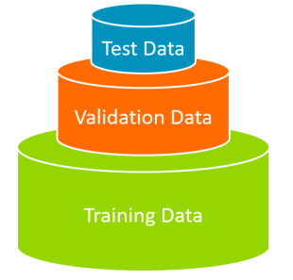
IoT/ML SW Platform – Usage for Real-world Data Collection
CMSIS-RTOS2
User Application Code
Capturing software for real-world data
FreeRTOS, RTX, …
BSD-Socket
Demo or test Interface
i.e. Voice Recognition
TCP/IP Stack with Security
Event Recorder
Board Layer
Demo I/O-Driver
HW Drivers
Ethernet-Driver
Device SDK with configuration
LEDs, Push buttons
Real-world input
Audio, Video, Sensors
Capture real-world input and store in data files
Notes:
Potential key customer: DSP Concepts. See email exchange:
From: Paul Beckmann <pbeckmann@dspconcepts.com> Sent: Wednesday, April 7, 2021 9:05 PM To: Reinhard Keil <Reinhard.Keil@arm.com> Subject: Re: Compiler comparison / Feedback on Audio API interface
Hi Reinhard,
We are our testing with MDK V5.31.0.0. Here is the detailed info:
For IAR, we used v8.50.1. For GCC, it was the version included with the ST tools. Not sure exactly which version this was.
We have done further benchmarking across different signal processing operations. I picked this one because it was a recent issue with a customer and highlights how GCC can be slow. For other kernels, the cycle counts are comparable.
Being able to run on the FVP would be very interesting for us. I see several advantages:
We can optimize and profile for cores before they are publicly available. For example, we are getting requests for M55 performance numbers but there are no announced CPUs.
Get accurate measurements of system level issues. Caching and memory accesses have a huge impact.
Could fit with our continuous integration plans so that we don't have to (always) test on external hardware.
We are speaking with Reed Hinkel about "cloud based profiling". I would like our customers to create a design in Audio Weaver and then upload the design to our website for profiling. They can select which processors to run on and then get detailed results showing where resources are consumed. The VFP would be ideal for this.
I also had one of my firmware engineers review the SAI interface. I'll provide all of his comments and you can see what is relevant:
It is well written and to make sure I understand it, low-level drivers must be written depending on the device.
You have to kickstart the driver with calls to ARM_SAI_Receive() or ARM_SAI_Send() which are non-blocking.
A callback function is registered during init called ARM_SAI_SignalEvent(event) which is called when the above completes with respective bits in the parameter "event" for each.
ARM_SAI_Receive() or ARM_SAI_Send() mention that DMA is typical, but I am not sure if those two calls can be one time only and then the guts of the driver can provide calls to ARM_SAI_SignalEvent(event) on each DMA interrupt afterward. If yes, then it can work with our BSP's.
The protocols cover about everything with User Defined Protocol allowing for generic TDM configuration.
They are missing specification of left or right adjusted data and now to save captured data in memory. For instance if the data is 24-bits, is it saved right adjusted with sign extension or left adjusted?
In general, you may capture even 16-bit data and want to save it in 32-bit memory left or right adjusted.
The same API and supported protocols should include PDM (DMIC) input. The RT685 and NXP PDM IP in general have a means to convert to I2S, but that may not be on all parts and should not be necessary.
Most devices have multiple stereo PDM ports that can capture data and send to two different DMA channels (left and right).
This API seems to support single stream, interleaved, not multi-stream from one device. Is that correct?
The documentation is not clear how you mask the TX event, bot allow the RX event and so on. Guessing it is in there.

Slide 33
FVP/FM Streaming Peripheral Extension
First PoC implementation of Streaming Interface
FVP Implementation for Linux and Windows
The streaming peripheral is flexible and allows to implement a wide range of use cases. We show an audio interface in the first example.
CorStone-300 (or Cortex-M4) Model
Also, the Cortex-M side implements a flexible streaming peripheral that can serve a wide range of use cases. Initially we show audio.
Cortex-M User Application
Audio Interface
Python Streaming
Interface
System C Virtual Streaming Interface (System C Peripheral)
Audio Peripheral Driver
Algorithm under Test
Test Script
Audio files
In an example we provide the same Audio Peripheral Driver API implemented on a real microcontroller
Closed Source

Slide 34
GitHub
Step: Environment setup
AWS
Step: Run avhclient
Step: Run AVH Actions
avh.yml file defines AVH Actions
Execute actions defined in the avhlcient .yml file: AMI instance setup,
project build, run, etc.
Source files (*.c, *.cpp, *.h)
Executable files (*.axf, *.elf)
AVH AMI provides necessary tools: FVP models, compilers, ...
Python script files (*.py)
Other input files (*.wav, …)
Output and log files
Project files
Output and log files
Step: Publish results and artifacts

Slide 35
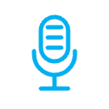
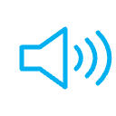


FVP_Audio Example Firmware
FVP_Video Example Firmware
Copy Audio Stream
Copy Video Stream
Software Layer: Board
Software Layer: Board
vStream_AudioIn
Interface
vStream_AudioOut
Interface
vStream_VideoIn
Interface
vStream_VideoOut
Interface
VSI Python Script (FVP)
VSI Python Script (FVP)
VSI0 AudioIn
VSI1 AudioOut
VSI4 VideoIn
VSI6 VideoOut
AudioIn.wav
Microphone
AudioOut.wav
Speaker
VideoIn.mp4
Camera
VideoOut.mp4
Screen

